Slide 1
Data Science Unit 1
GitHub and Version Control
Notes:
In this session we are going to introduce you to github and version control, two very important processes in the data science step.

Slide 2
What is Version Control?

Slide 3
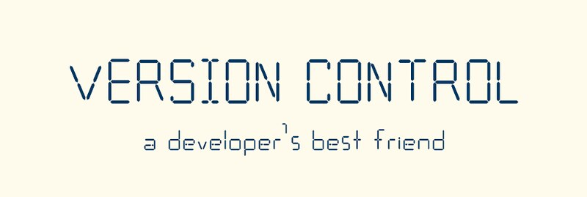
Version Control
Notes:
Does anyone know what we mean by version control?
It is a way we can monitor changes to code/software/documents over time, so that if an error is made, we can restore a previous version from before the mistake happened. Consider video games, many have a save function so that if you mess up afterwards, you can go back to the save point and continue without losing all your progress.
This is the same for data science and data analytics. You are going to be cleaning and manipulating data sets, but what if you make a mistake and mess up the data (this is why we always save an original copy)? Or, you are writing a block of code and accidentally remove some important lines and lose them. What do you do?
Version control! Using software like Github we can regularly save our work in a way that never overwrites previous versions. This way if we want to restore something we can easily locate it. Google Drive offers a similar idea for documents [demo version control in GDrive by clicking on the link last edit…]

Slide 4
Github
Notes:
So what is Github?

Slide 5

Github
Notes:
Github is a free website where you can store your code! For this course we are going to encourage you to save all your progress to Github, which I will show you how to do in a minute. You can set your uploads to private so nobody else can see your work, however you still shouldn’t upload company data there...
However, Github offers an enterprise version for companies which is secure. Check with your employer, they may already have an account which is a place you can store your work projects in a safe manner.

Slide 6
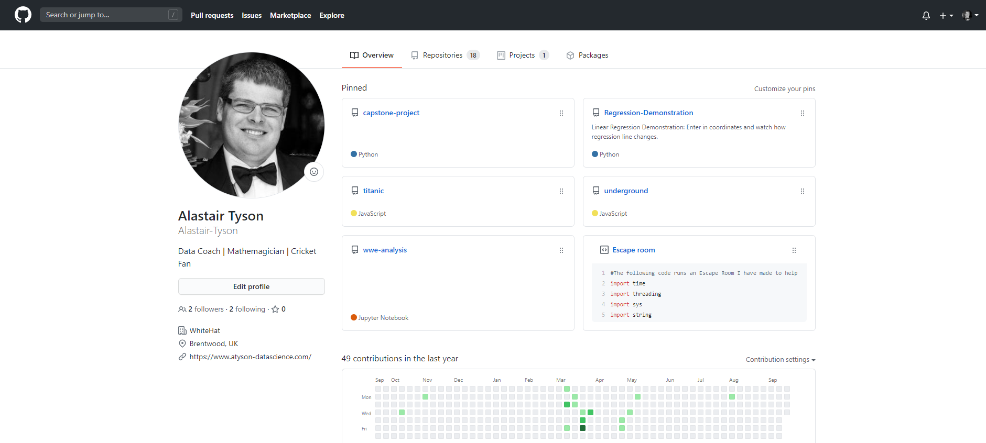
Github
Notes:
Here is an example of one of our coach’s Github page (which you can visit at https://github.com/Alastair-Tyson). On the page you can see repositories, each of these is where the materials for various projects have been stored. Each time you start a new project, you should create a new repository.

Slide 7
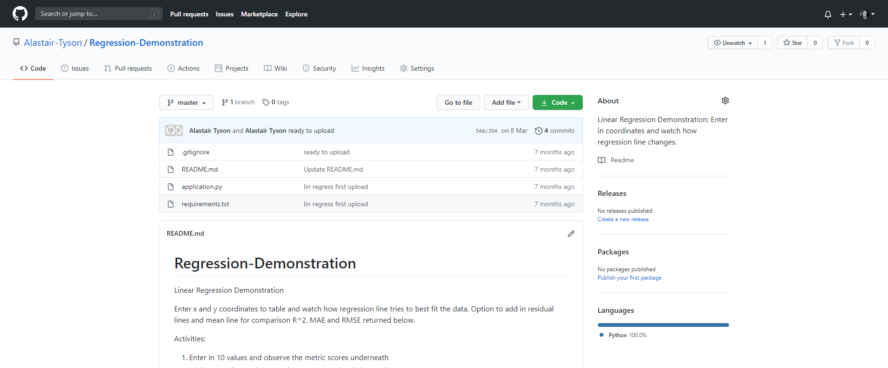
Github
Notes:
You can see within a repository all the files that have been created. Each time you want to save your work you ‘commit’ the new version, note this does not overwrite or delete previous versions.

Slide 8
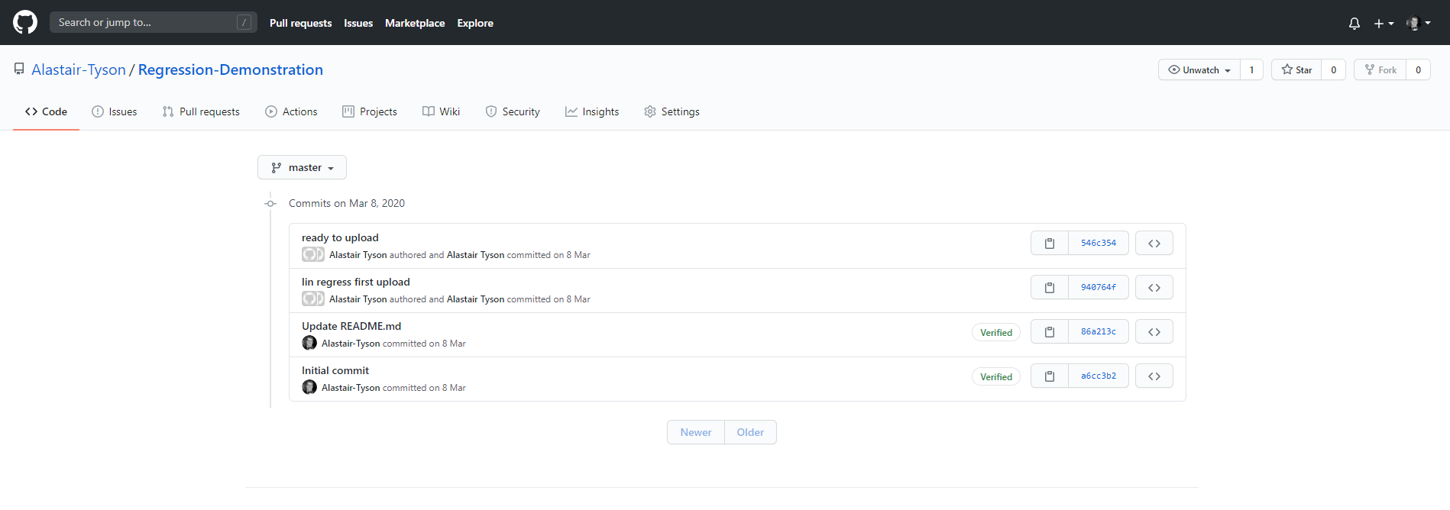
Github
Notes:
If you click on commits you can see all previous versions.

Slide 9



Github
Notes:
Before we look at using Github, there are a few other phrases you should be aware of. The first are pushing and pulling. Github is an online store for your data/files while you are obviously also going to have a local version on your computer. When you send something up to Github, this is called pushing. When you download to your machine it is called pulling.
When you push to Github, the repository will merge in your local edits and save them as part of version control. When you pull, your computer will merge your local version with the one from the remote. If there is a conflict between the remote and local versions, a merge will fail. You will likely need to then edit the local version so it closer matches the remote.
Forking is the process of cloning another repository. Many of the repositories on Github are open source- you can use the code! However, the owner will not want you editing their stuff, so they don’t give you that access. Instead you can ‘fork’ their repository, therefore creating your own version. You are free to edit this stuff as much as you want as it will not affect the original ‘master’ version.
When working on group projects, it is common to have one master version and all developers would have their own forked version. Whenever someone has done something the rest can use, they will try and merge their version with the master with the owner resolving any conflicts.

Slide 10
Github
Notes:
To use Github, you will need to setup a free account. Go to www.github.com and create an account if you haven’t already. I would also download the Github desktop app as it is very easy to use. In this session I will show you how to save your work their using your computers command line and the desktop app.

Slide 11
Using the app
Notes:
First we are going to look at using the Github app to manage our repositories, then we will look at using the command line. The reason for this is sometimes on a work machine you will not have access to use the command line, and so will need the app.
[I would recommend demo-ing this on the app itself, use the guidance in the following slides to help you]

Slide 12
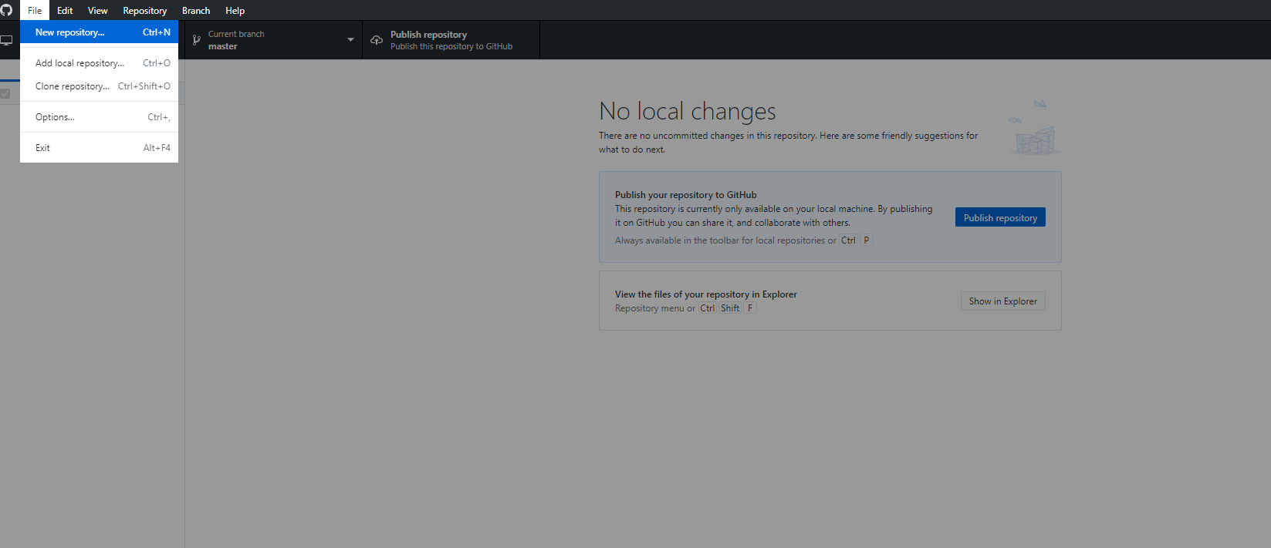
Github
Notes:
When you first open up the app you will need to connect it to your GitHub account by logging in, but then you will find it will be empty, so click file then new repository so we can build our first one.

Slide 13
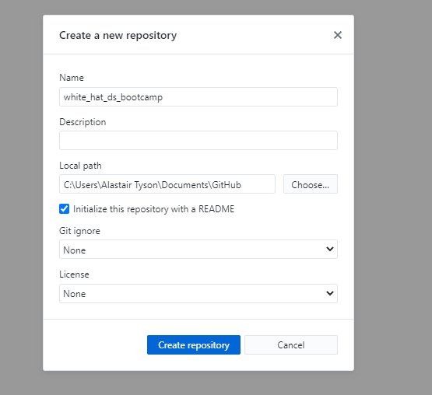
Github
Notes:
Give the repository the title whitehat_data_science and I would usually recommend ticking the box with README, this file is something we can edit later. Essentially, it is the information about what the repository contains, Git ignore is something to include if you are commiting code (python, R, etc).
We will store all content from the bootcamp in this folder.

Slide 14
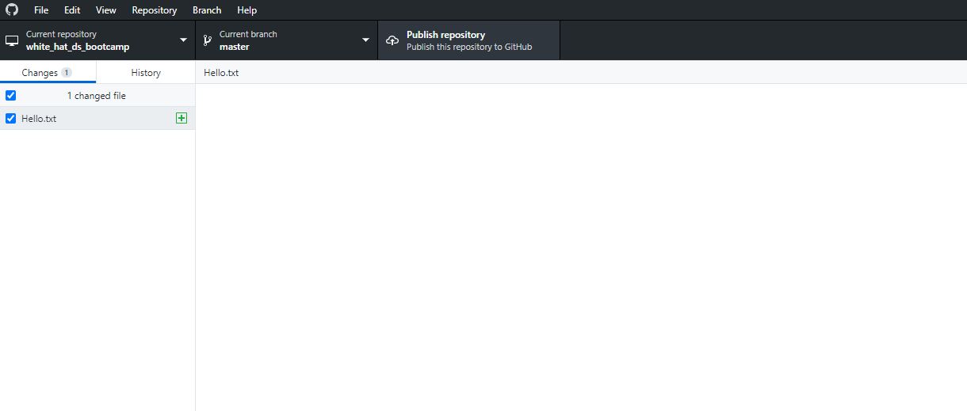
Github
Notes:
This repository is local to your computer, but you will also want to create a remote one. To do that click on publish repository, and then give your credentials (don’t select enterprise…).

Slide 15
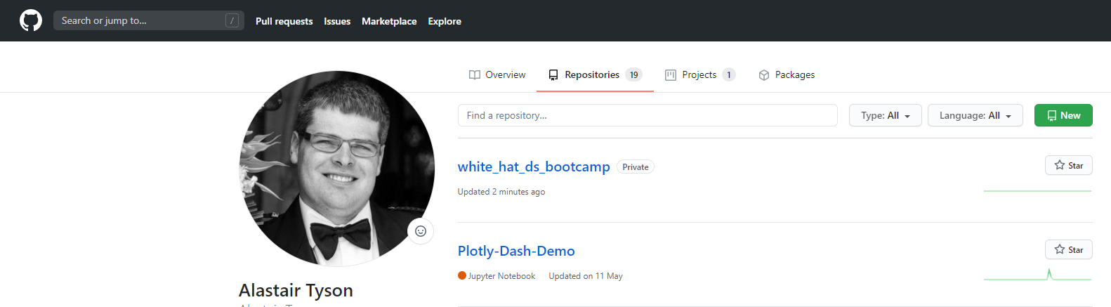
Github
Notes:
If you go to your Github account online and click on repositories you should see your local repository is now o the remote server

Slide 16
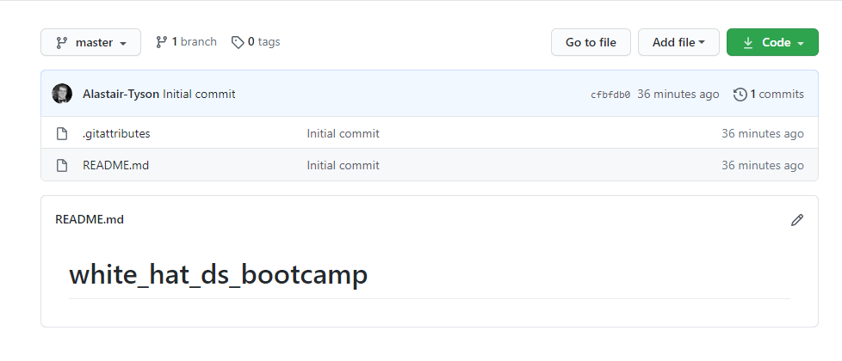
Github
Notes:
And there is the README, although we haven’t written anything in it yet.

Slide 17
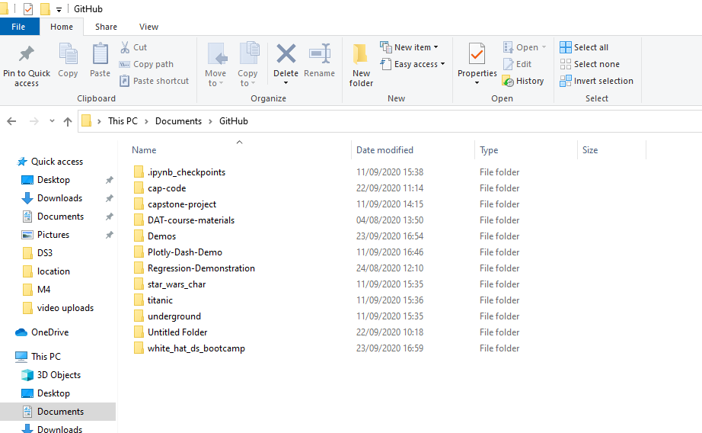
Github
Notes:
We have created our repository, let’s now put some stuff in it. Go to your documents folder and select Github, in there you should find your repository. It should contain the same files as what we just saw online.

Slide 18
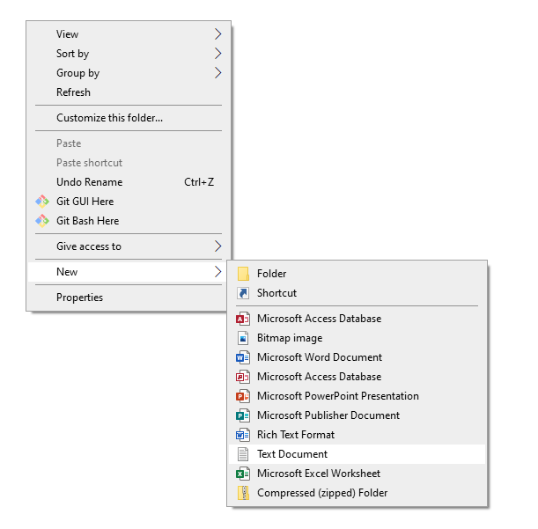
Github
Notes:
Let’s now add in some content- right click and select new text document. Call it whatever you want and write whatever you want in it.

Slide 19
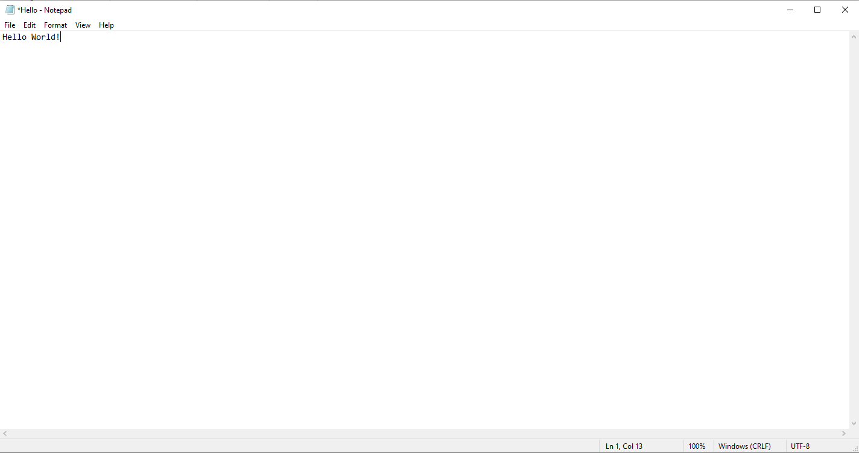
Github

Slide 20
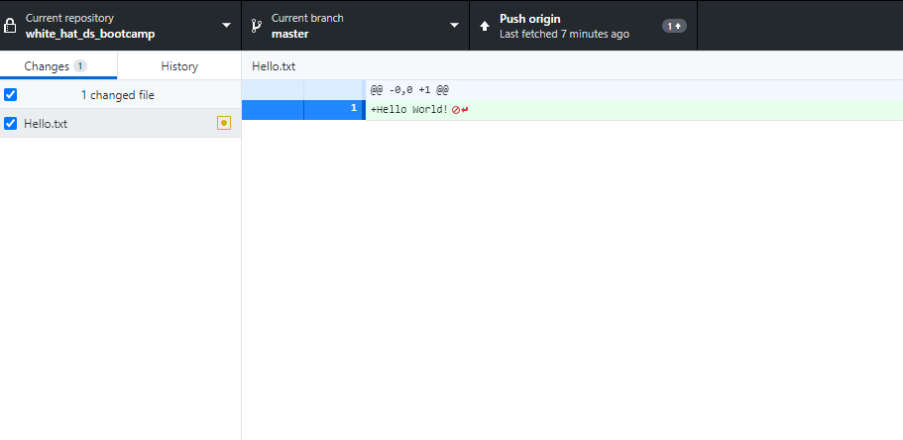
Github
Notes:
If you back to the GitHub app on your desktop you should now see this file is in your local repository! Every time you add a file, or edit one it will appear in the local repository on your github app as a new addition.

Slide 21
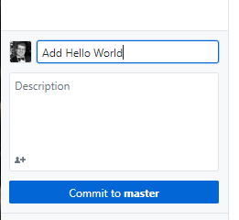
Github
Notes:
We have made a change to our local repository, but now it is out of sync with the remote one…. To merge the two we will need to push our local repo to the remote, but before we can do that we need to commit. At the bottom of the left toolbar you should see ‘Commit to master.’ Enter something into the title text box to indicate this change.
This is an important step, and what you title should be meaningful for the purposes of your version control (i.e. call it first commit, 2nd commit, etc not something random like custard). When you have given it a title (you can ignore the description) click commit to master- this has now committed your edit.

Slide 22
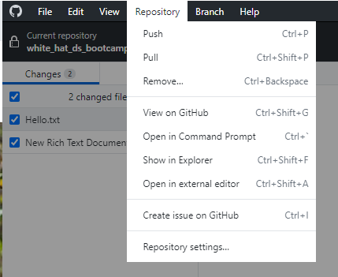
Github
Notes:
Next, click on repository at the top and select push (or press ctrl+ p), this will send your local changes to the remote. You can use this command box to pull from your remote too. Note: this is how you can transfer content between different machines you work on. From one computer you push to the remote repository and then on another machine you pull it!

Slide 23
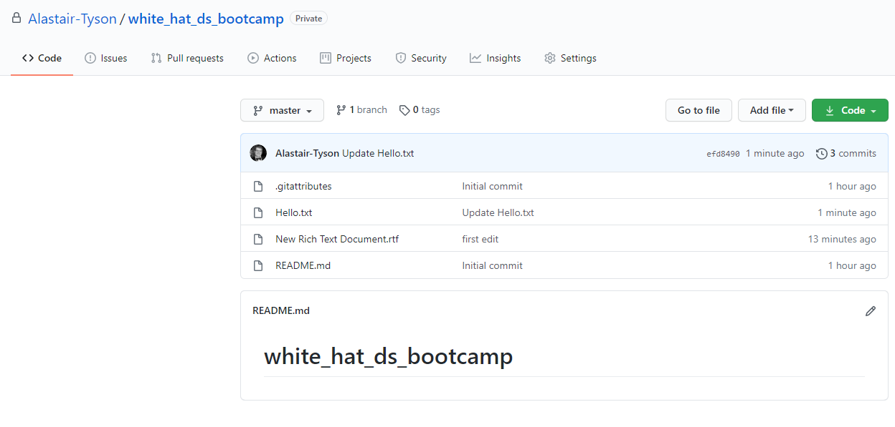
Github
Notes:
If you go back to the website you should see your commits!
Let’s demo a pull as well, select add file on Github and new file

Slide 24
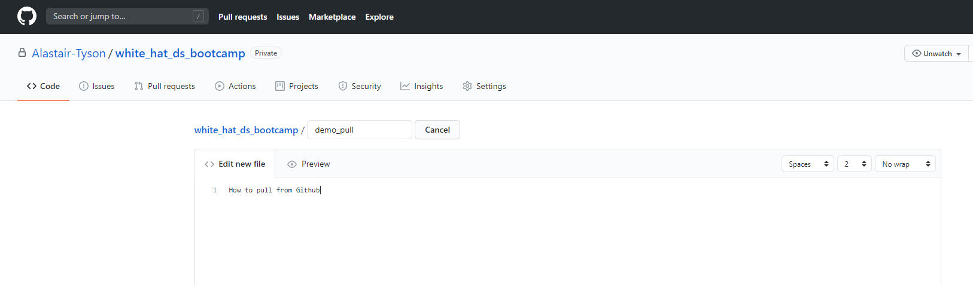
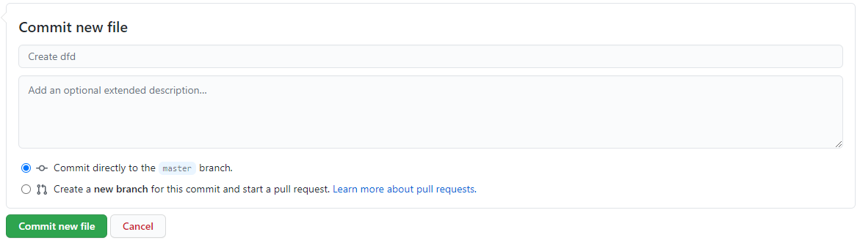
Github
Notes:
Again title it what you want and write whatever you want in it. When you are finished click ‘commit new file’ at the bottom to commit it to your remote repository.

Slide 25
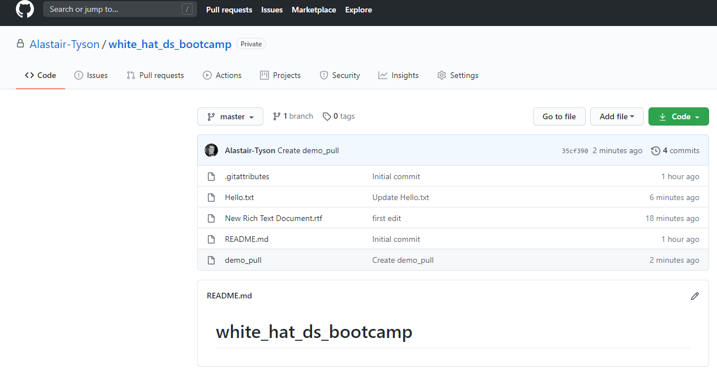
Github
Notes:
You should now see your new file in the remote repository, but it is not on your local machine!

Slide 26
Github
Notes:
Go back to the GitHub desktop app and select repository, but this time choose pull (or ctrl+shift+p) to update your local version

Slide 27
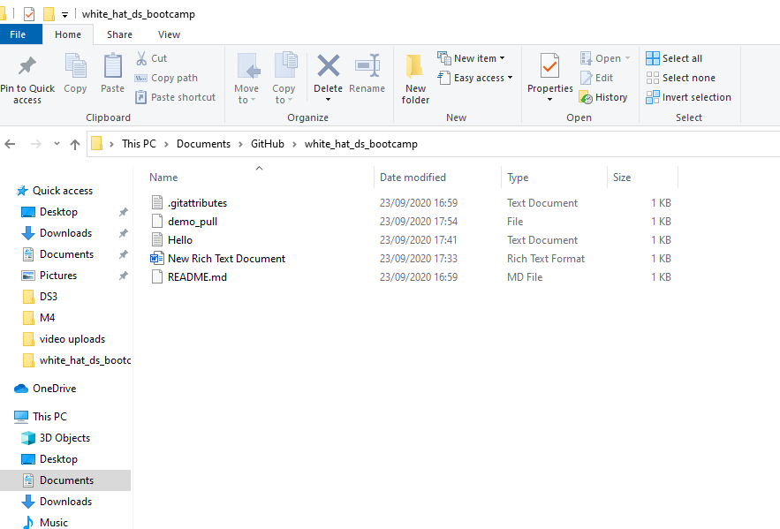
Github
Notes:
Now go back to your documents folder and you should see the file you created online is now also locally on your machine!
This is how you perform version control for your work. You should save all your work for this bootcamp using this method.
It is also possible to do this using the command line on your computer, I won’t show you how to do this, but you can research it in your own time.

Slide 28
Jupyter Notebook
Notes:
Now we know how to use Github and version control, let’s set up our python environment.
[Much of this section should be demonstrated live, the slides can help you learn it]

Slide 29

Python
Notes:
Python is a computer language invented in 1992 and has many applications in data science and computing in general. Essentially though it is a way of communicating with our computer. Computers speak in binary, we don’t and ultimately we want our computers to perform the calculations/build the ML models so we need a way to tell them that. This is where python steps in (there are other languages like R which do a similar thing).
Think of python like a postman. We write python code to tell the computer what we want it to do, this is then delivered to the computer which carries out the process. The computer then produces some output (maybe a solution to a calculation, or a visualisation) and then sends it back, in a form we can read.
Python interacts with the computer directly, so we can use the command line/terminal, but that is difficult to edit. Instead we use a python editor to allow us to edit the code. Common editors include atom, jupyter notebook and pycharm, but we will be using jupyter.

Slide 30
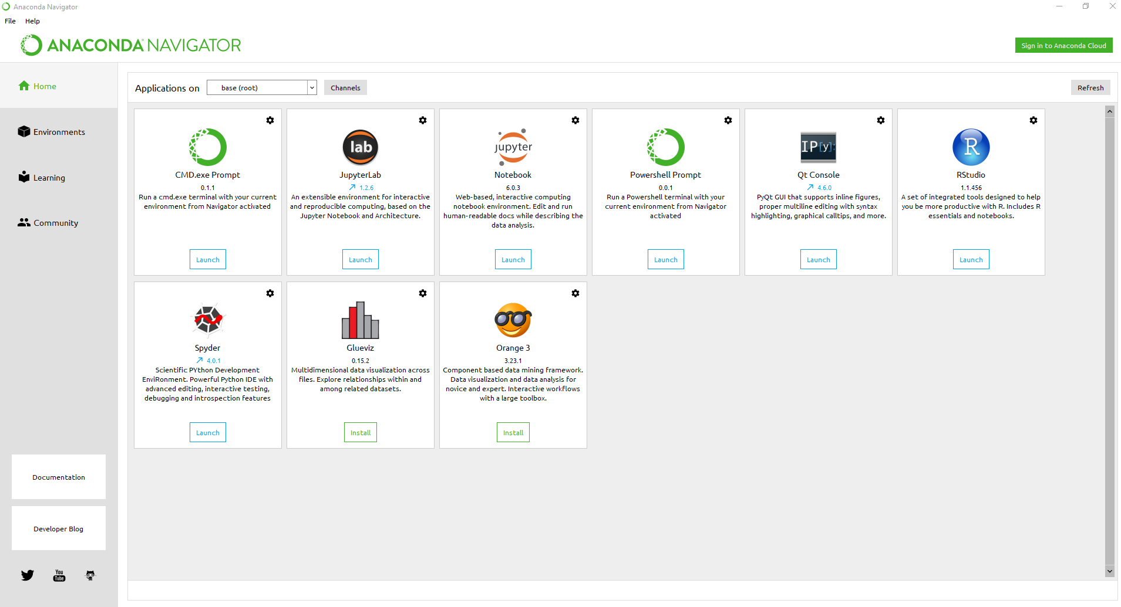
Jupyter Notebook
You should have installed Anaconda by now.
Open “Anaconda Navigator”. You should see this:

Slide 31
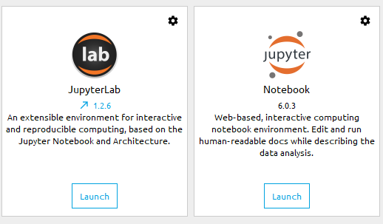
Jupyter Notebook
You should have installed Anaconda by now.
Open “Anaconda Navigator”. You should see this:
Check to see if Jupyterlab and Jupyter notebook are installed. They should show “Launch”
Notes:
Click on launch and that should open a terminal in your browser.

Slide 32
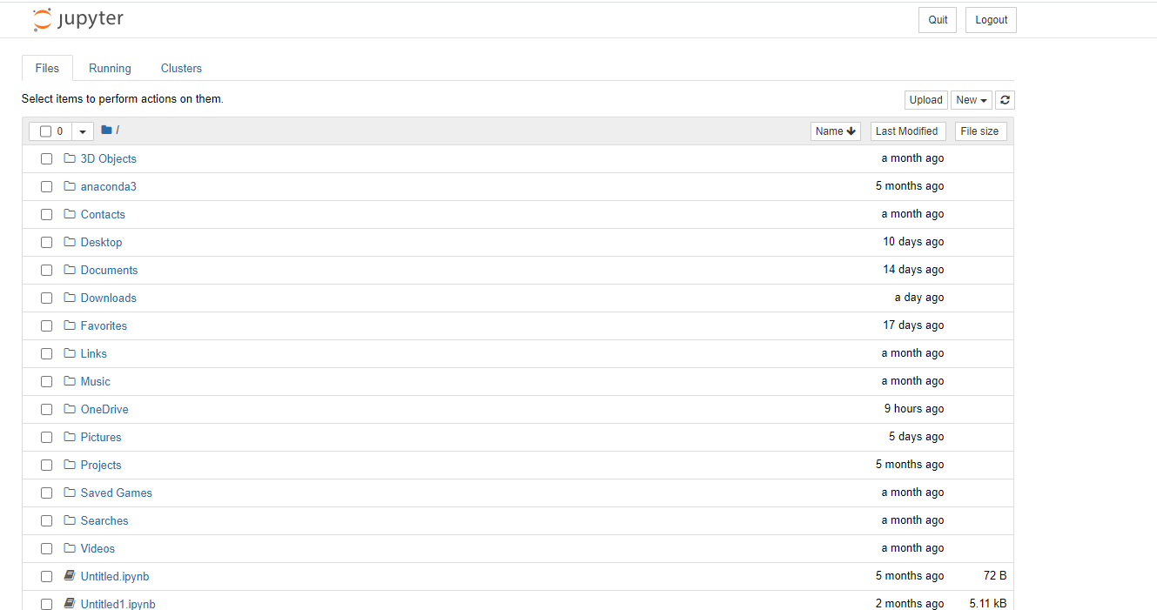
Jupyter Notebook
Notes:
You should see something like this, but for your own computer. This is your root directory, the tree where every file in your computer can be located. Navigate to documents, then Github, then the repository you just created

Slide 33
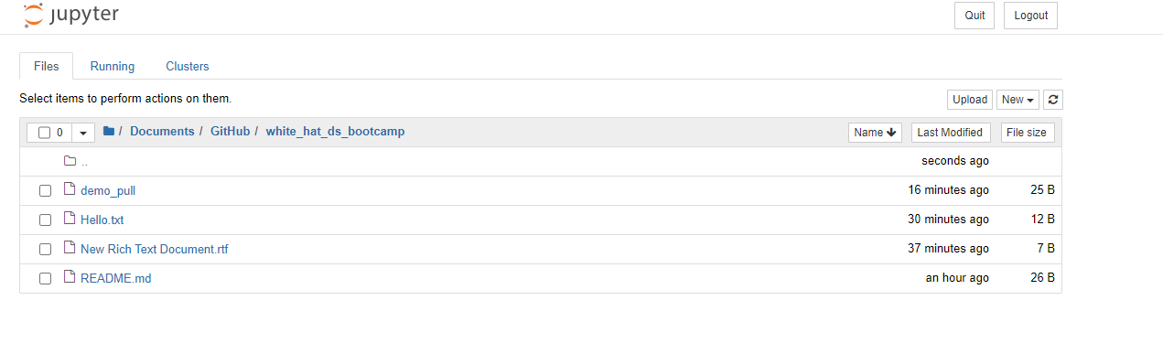
Jupyter Notebook
Notes:
You should see all the files you recently created. This is the same as navigating through the documents on your computer!
Let’s create our first Jupyter Notebook- select new- then Python 3

Slide 34
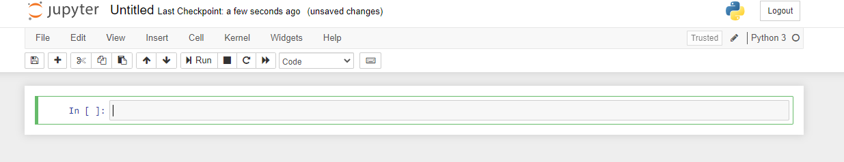
Jupyter Notebook
Notes:
You should now see something like this, this is a notebook! We can title it whatever we want (just click on the title) and can start adding code.

Slide 35
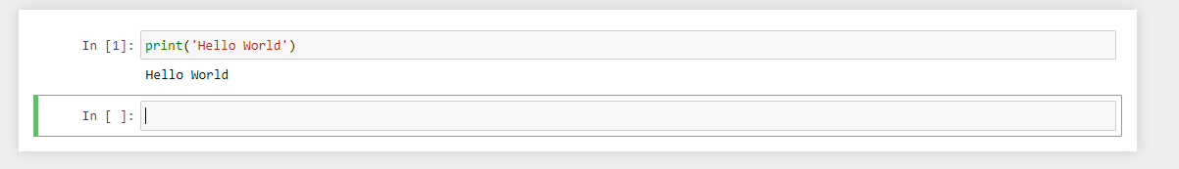
Jupyter Notebook
Notes:
Start with something simple like print(‘Hello World’) then click run (either by pressing run, or shift+enter).
You have just written your first python script.
Let’s no commit this to our remote repository, see if you can do this on your own…
Hint: Go to Github app, give commit a name then click commit to master, then select push

Slide 36
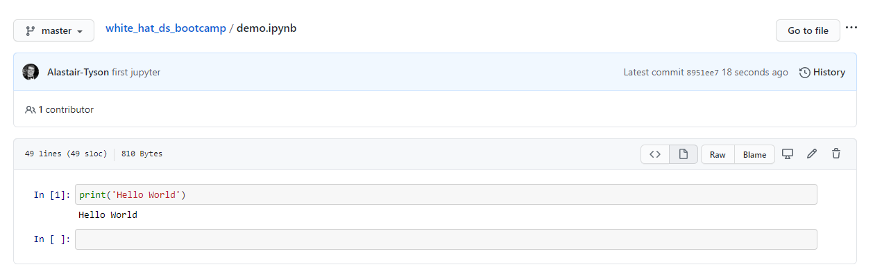
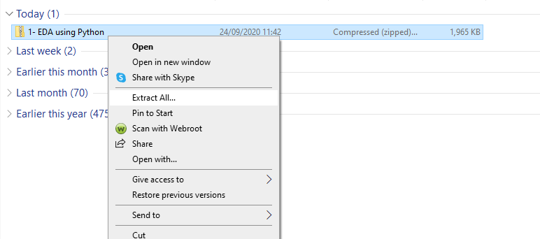
Jupyter Notebook
Notes:
If you have been successful you should now find this notebook exists on your online GitHub account!

Slide 37
Activity
Notes:
Now we have established how to set up our python environment and save our work to Github, let’s do an exercise before we start to learn some more python!

Slide 38

Activity
Create a new repository on your online Github account
On your desktop app, go to file and select ‘clone repository’ and pull the new one you just created
If you have any personal projects that you don’t mind going public, put them in this folder
Change to this repository on your app and commit the changes
Push to the remote repository and check to see if it worked
10 minutes

Slide 39
Moving Forward
Notes:
Before we get into coding we need to establish where we are going to store the files from bootcamp. All the necessary notebooks and data files will be given to you in a zipped file (either downloaded from applied, or emailed directly by coach). At the start of each bootcamp extract the data from the zipped files into the Github folder you created earlier in this session. Remember to commit and push the repo to the remote! This will save your work online so you can pull it to different machines.

Slide 40
Jupyter Notebook
Notes:
Navigate to the zip file in your downloads folder and select extract all

Slide 41
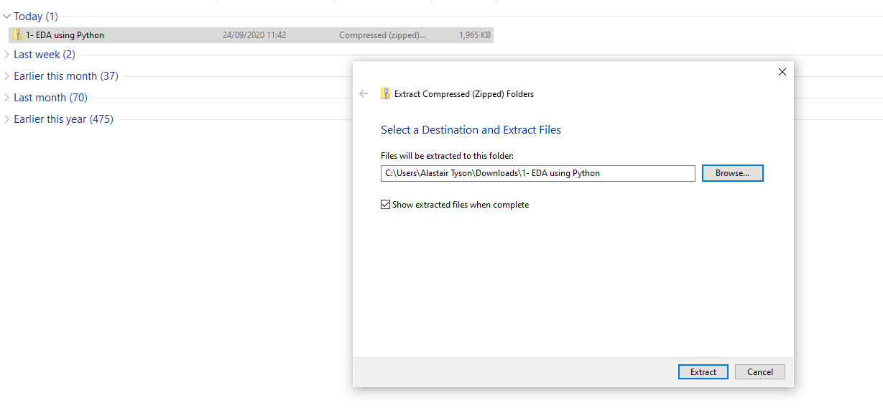
Jupyter Notebook
Notes:
Select browse

Slide 42
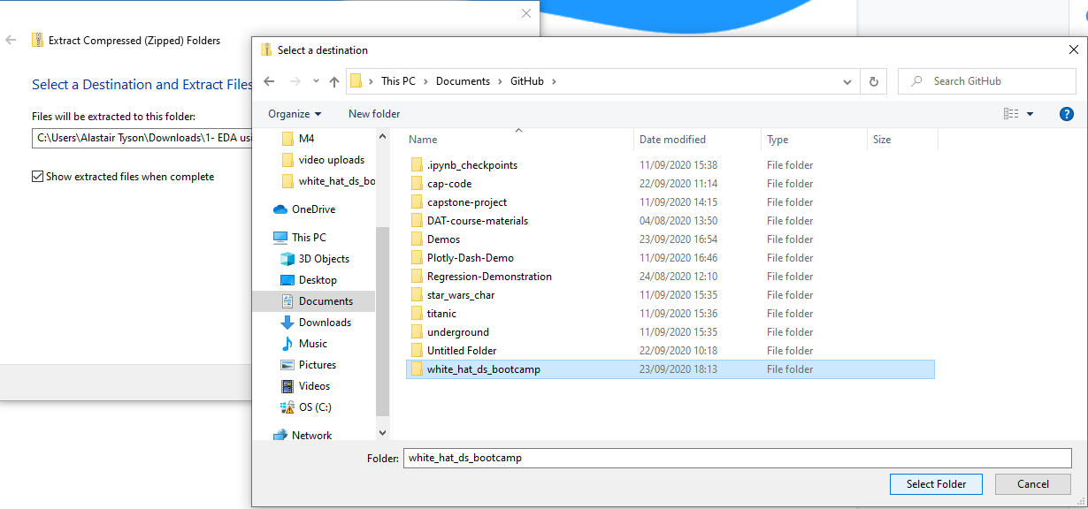
Jupyter Notebook
Notes:
Navigate to the folder for your white_hat_ds repository and then click select folder. Then click extract on the first dialogue window

Slide 43
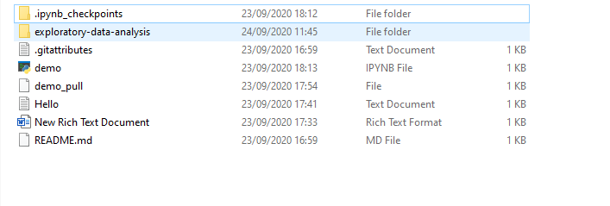
Jupyter Notebook
Notes:
You should now find the files inside your local repository. When you launch jupyter notebook, navigate to this folder to access the notebooks. Remember to commit to master and push to the remote repository to save your work!
[Do this now with DS1 zip file]

